Slide 1
Highest Exposure, Highest Stakes: AI's Impact on Work
Leveraging AI and Model Context Protocol (MCP) to Automate Complex Patent Workflows
Copyright © 2025 BLACKHILLS AI

Slide 2
Before We Get Started
Recording
A link to the recording and slides will be emailed to all registrants.
Recording
Type in the question box, and we will answer in real time or during the Q&A.
Social
Follow us on LinkedIn, Facebook, Youtube, and/or Instagram or visit blackhills.ai to see upcoming and on-demand webinars.
Copyright © 2025 BLACKHILLS AI

Slide 3


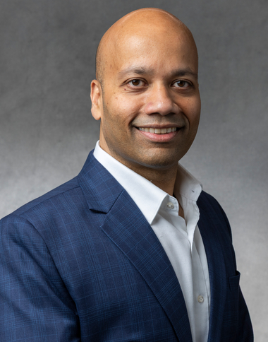
Panel
Tom Marlow
Chief Artificial Intelligence Officer, Black Hills AI
Manjeet Rege, PhD
Director of Center of Applied Artificial Intelligence and Professor, University of St. Thomas
Advisor to Black Hills AI
Copyright © 2025 BLACKHILLS AI

Slide 4
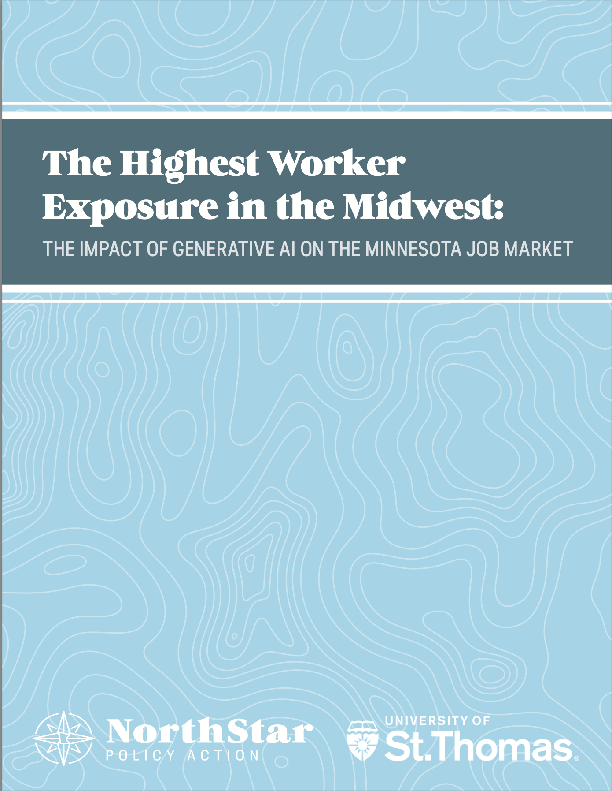
Aaron Rosenthal, PhD
Research Director
North Star Policy Action
Manjeet Rege, PhD
Professor and Chair
Department of Software Engineering & Data Science
Director, Center for Applied Artificial Intelligence
University of St. Thomas

Slide 5
VELOCITY: BEYOND THE CHATBOT
35% WIN RATE
AI now outperforms human experts on professional benchmarks.
7-MONTH HALFLIFE
Capability complexity is doubling twice a year.
Source: OpenAI 'GPQA: A Graduate-Level Google-Proof Q&A Benchmark' (2024); Epoch AI 'Trends in Frontier Model Capability' (2025).

Slide 6
80%
ENTERPRISE ADOPTION
13% DECLINE
Drop in entry-level hiring within highly exposed sectors.
Source: Gartner 'Top Strategic Technology Trends for 2025'; Burning Glass Institute 'AI and the Future of Entry-Level Work' (2025).

Slide 7
THE GREAT DECOUPLING
OLD MAP (2020)
NEW REALITY (2026)
17% EXPOSURE
33% EXPOSURE
Source: Webb (2020) 'The Impact of AI on the Labor Market'; Rosenthal & Rege (2026) 'The Impact of Generative AI on the Minnesota Job Market'.

Slide 8
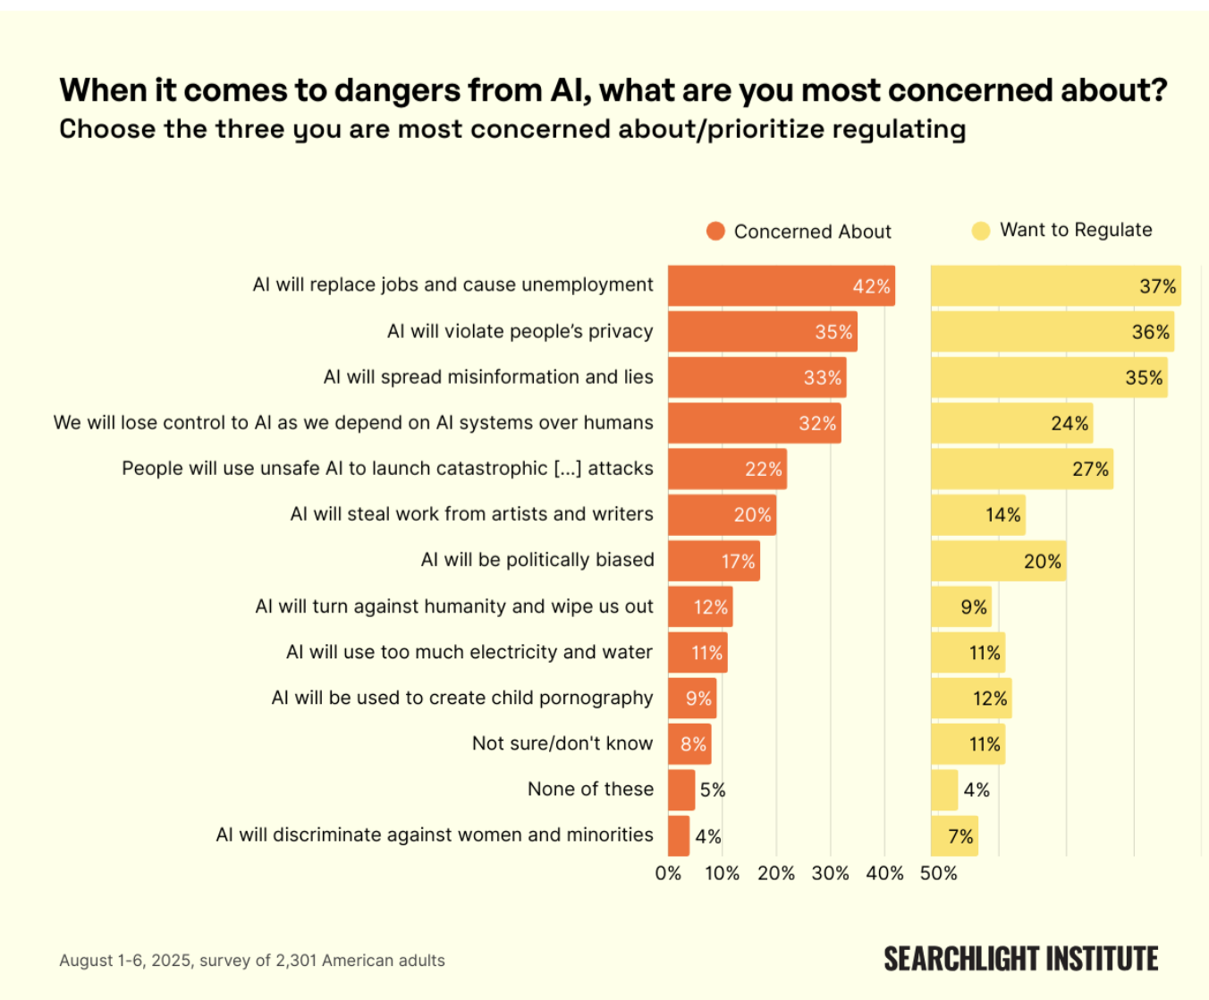
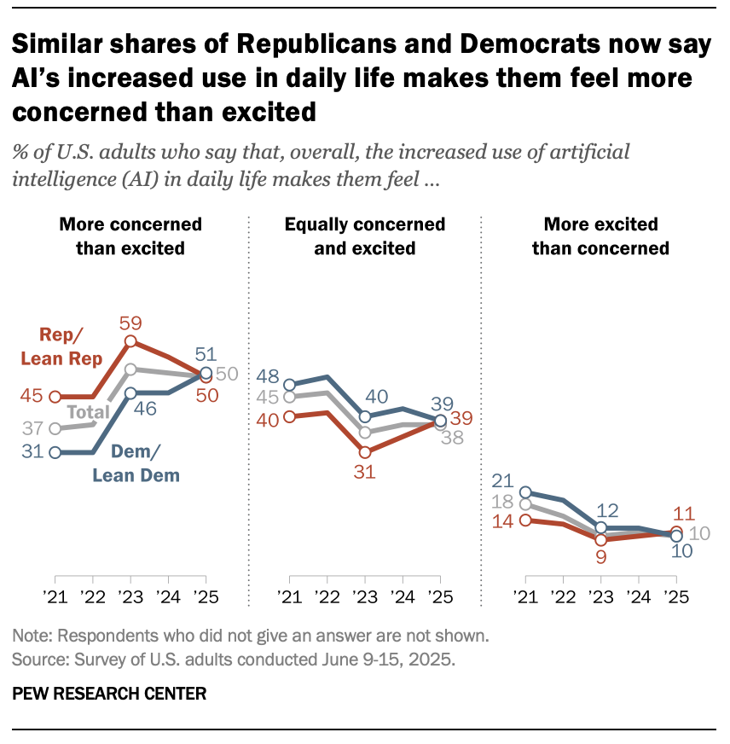
WORKER ANXIETY ABOUT AI

Slide 9
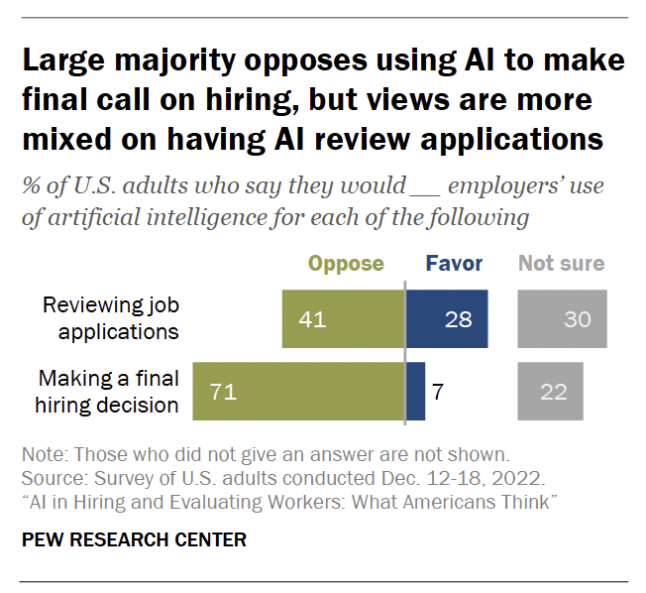
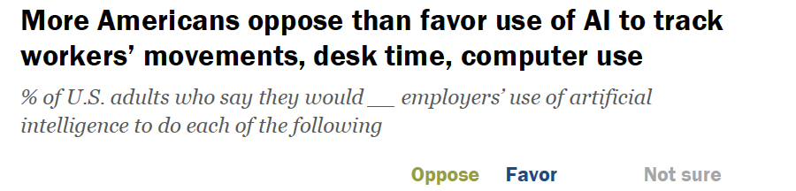
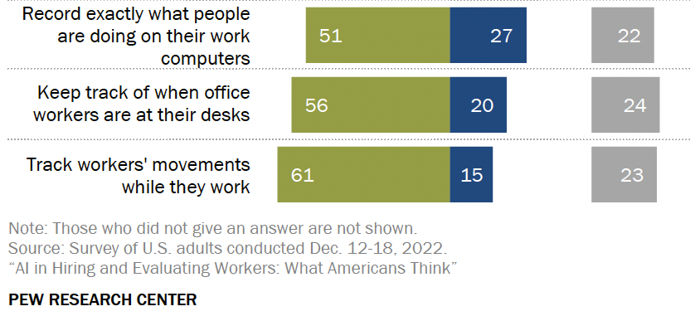
WORKER ANXIETY ABOUT AI

Slide 10
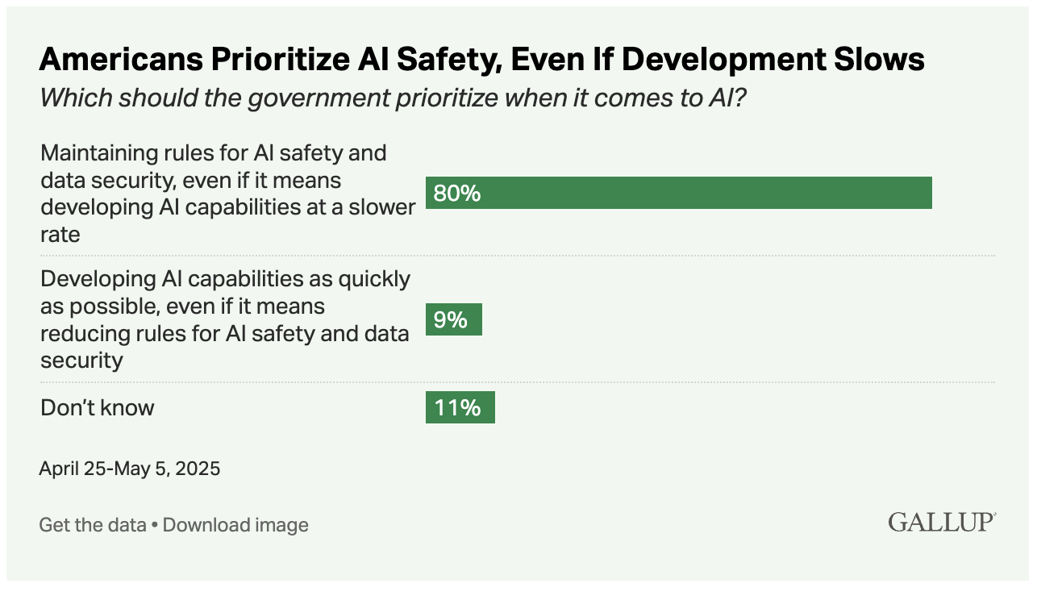
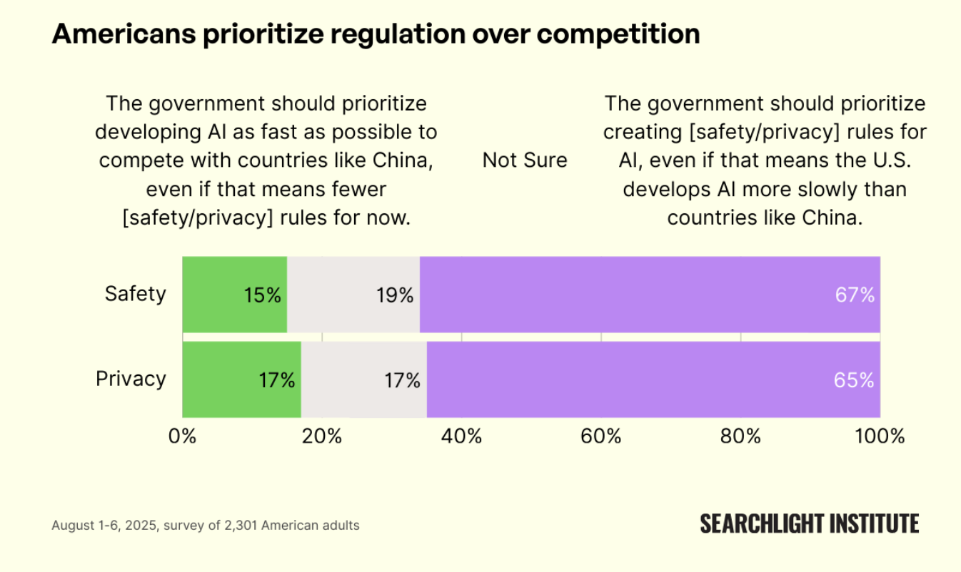
WORKER ANXIETY ABOUT AI

Slide 11
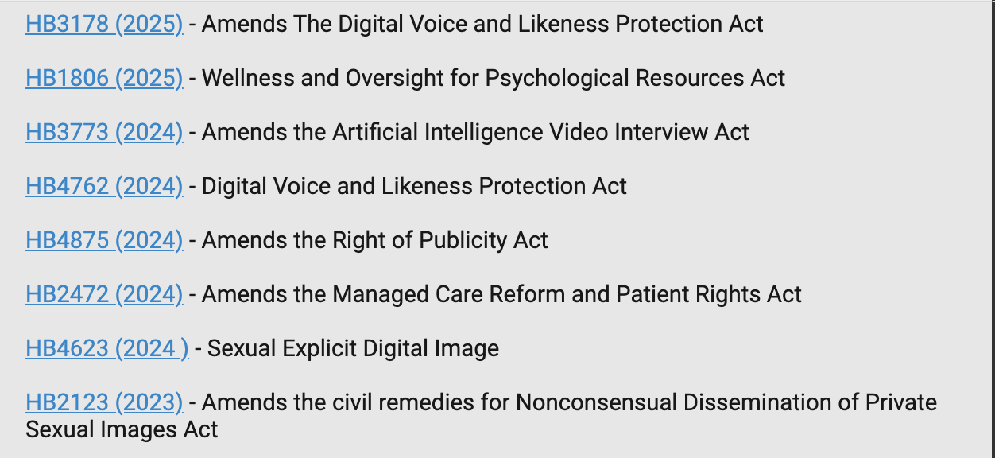
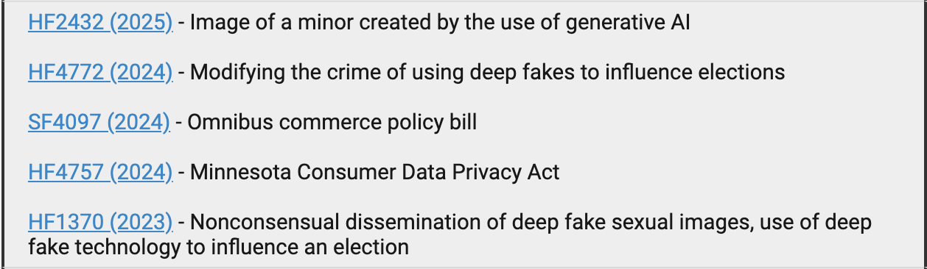
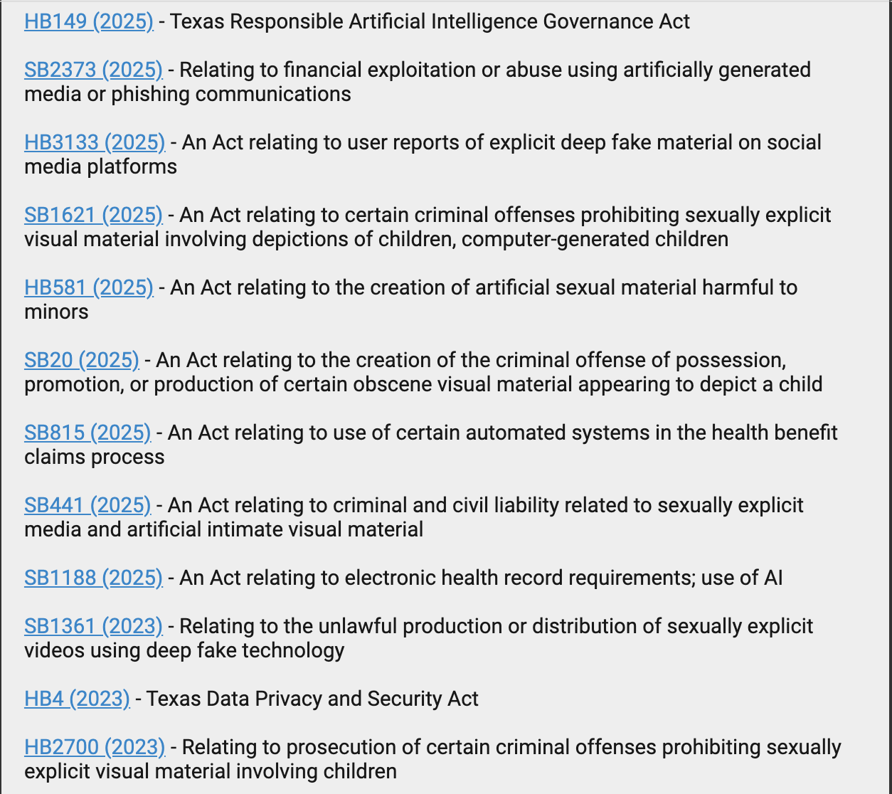
Illinois
LEGISLATIVE INACTIVITY
Minnesota
Texas

Slide 12
EXPOSURE ≠ REPLACEMENT
Exposure measures the degree to which AI can assist, augment, or automate specific tasks—not the elimination of the worker.
AUGMENTATION
TRANSFORMATION
DISPLACEMENT
AI handles the drudge work; human productivity scales.
The nature of the role evolves (e.g., Writer to Editor).
Only a subset of exposure leads to full task replacement.
Source: Felten, Raj, and Seamans (2023) 'Occupational Heterogeneity in Exposure to Generative AI'.

Slide 13
DATA-DRIVEN PRECISION
We merged global AI benchmarks with Minnesota’s real-time payroll data to see exactly where the frontier meets the workforce.
1. GLOBAL BENCHMARKS
Oxford/Wharton/OpenAI datasets mapping GenAI capabilities to 19,000+ distinct work tasks.
2. OCCUPATIONAL TAXONOMY
Federal O*NET database analyzing the specific day-to-day responsibilities of 900+ job categories.
3. LOCALIZED HEADCOUNT
Minnesota DEED payroll data reflecting the state's unique 'Headquarters Economy'.
Source: Eloundou et al. (2023) 'GPTs are GPTs'; Minnesota DEED OEWS 2025.

Slide 14
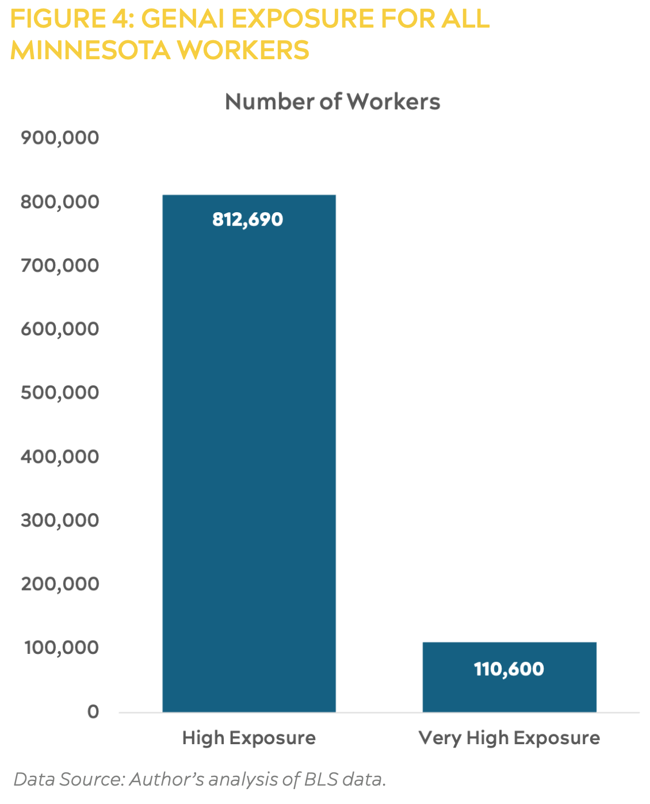
FINDINGS
Roughly one-third of MN workers are in high GenAI exposure jobs

Slide 15
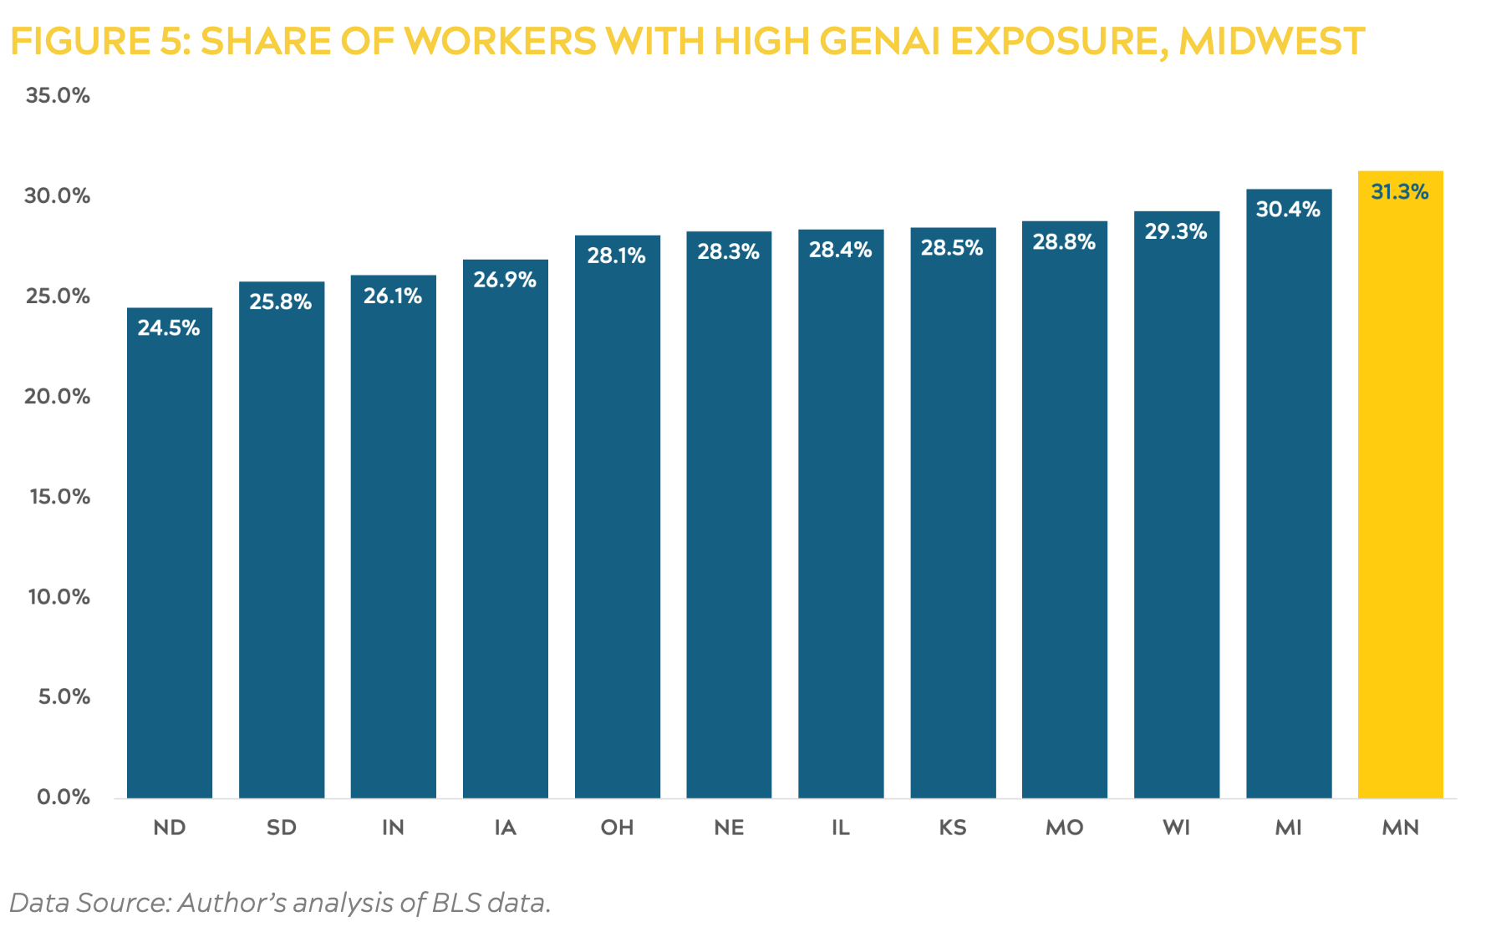
FINDINGS
MN workers are the most exposed in the Midwest (and 10th most exposed in the nation)

Slide 16
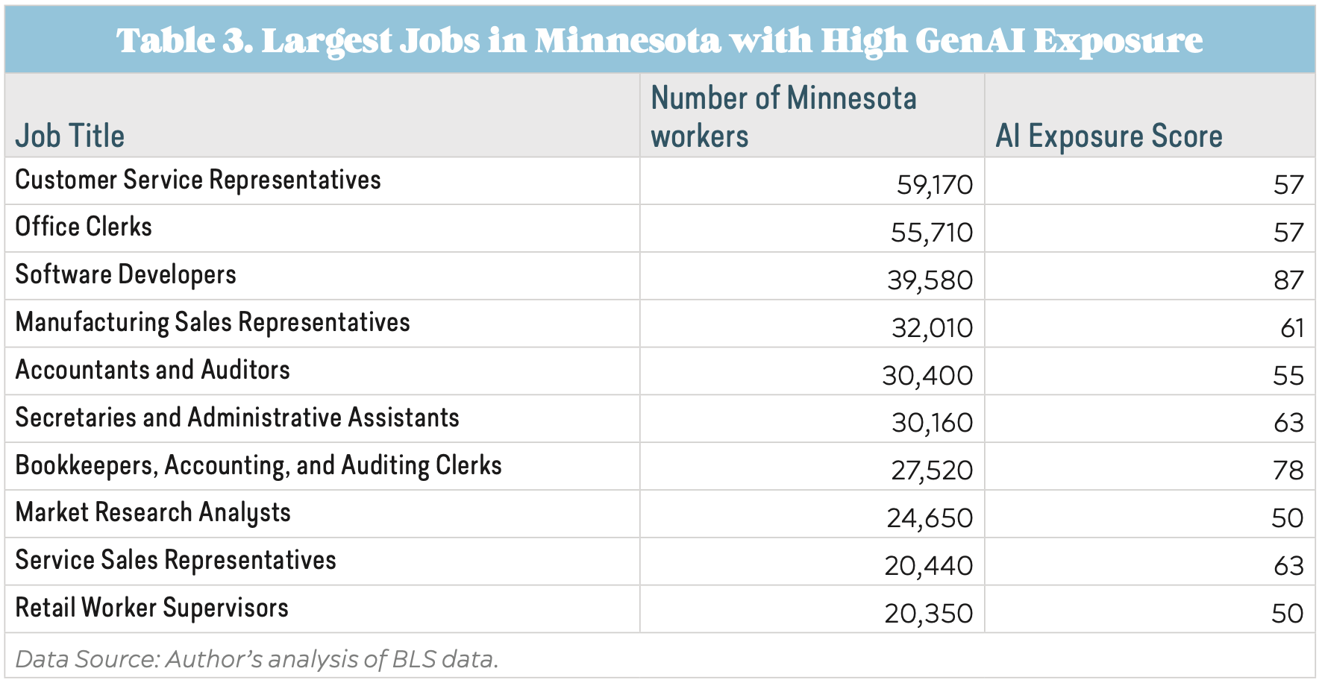
FINDINGS
MN workers are the most exposed in the Midwest (and 10th most exposed in the nation)

Slide 17
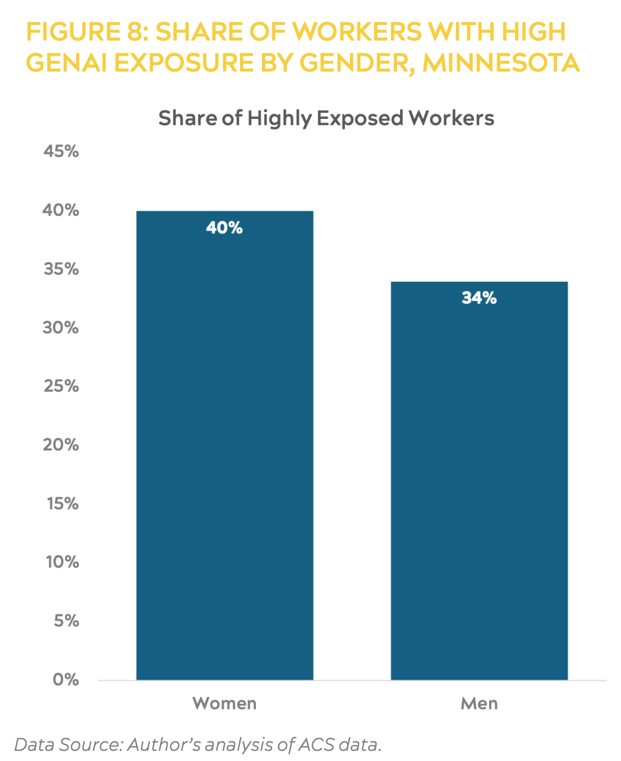
FINDINGS
Female workers in MN are more likely to be in highly exposed jobs

Slide 18
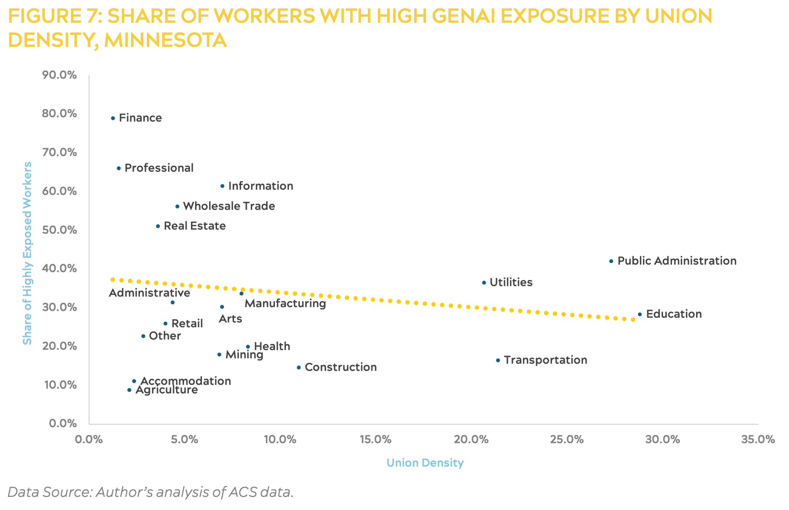
FINDINGS
Industries with lower union density contain higher levels of AI exposure

Slide 19
THE PATH OF THE FRONTIER: TOP EXPOSED JOBS
Interpreters & Translators - 88% Exposure
Translation, proofreading, and technical adaptation.
Legal Professionals - High Exposure
Contract analysis, legal research, and document drafting.
Financial Analysts - High Exposure
Data synthesis, report generation, and trend forecasting.
Marketing Managers - High Exposure
Content creation, market research, and campaign planning.

Slide 20
MINNESOTA'S CONCENTRATED RISK
PROFESSIONAL & TECHNICAL SERVICES
Highest Exposure: Management, legal, and engineering roles central to MN HQ economy.
FINANCE & INSURANCE
High Exposure: Underwriting, risk assessment, and claims processing.
INFORMATION TECHNOLOGY
Significant Shift: Entry-level software development seeing immediate 13% hiring decline.
RETAIL & CUSTOMER SERVICE
Operational Augmentation: High adoption of AI assistants for front-line support.
Minnesota has the 10th highest exposure rate in the nation.

Slide 21
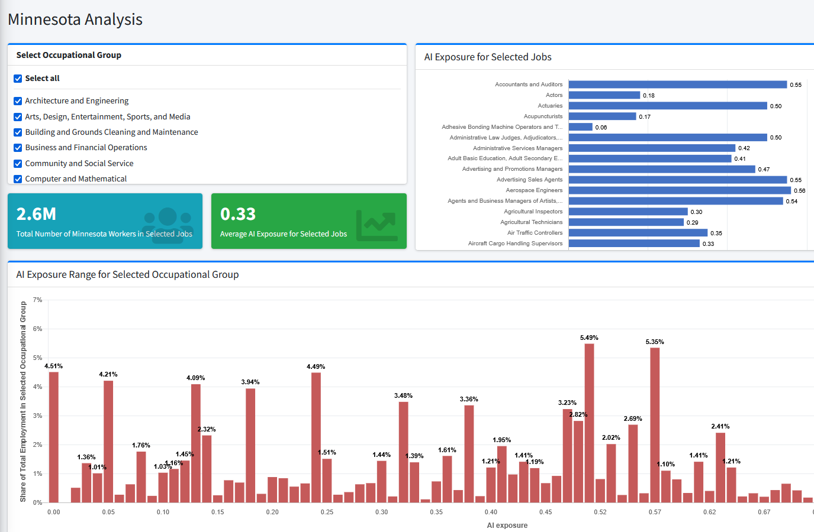
DASHBOARD

Slide 22
WHAT CAN BE DONE?
BOOST THE CAPACITY FOR WORKERS TO EXERCISE VOICE IN AI IMPLEMENTATION
REGULATE THE THREE Ds OF AI RISK:
DIGITAL SURVEILLANCE
Protect worker privacy from invasive data collection
DECISION-MAKING
Prohibit AI from making important employment decisions
DISPLACEMENT
Prepare workers for AI use in the workplace

Slide 23
THE ACTION PLAN: PREPARING THE WORKFORCE
WORKER RE-TRAINING
Establish state-funded 'AI Reskilling Grants' specifically for highly exposed sectors like Legal, Finance, and Office Support.
K-20 AI LITERACY
Integrate AI education into standard curricula to ensure the next generation is 'AI-Fluent' from day one.
WORKER VOICE
Boost collective bargaining to give workers a seat at the table during AI implementation decisions.

Slide 24
THE FRONTIER: AGENTIC WORKFORCES
FROM TOOLS TO TEAMMATES
AI is evolving from a system you ask (Chatbots) to a system that acts (Agents). Agents can execute multi-step workflows autonomously.
Impact: Roles will shift from 'Task Execution' to 'Strategic Oversight' and 'System Governance'.

Slide 25
The View from the IP Frontier
Legal professionals just ranked “high exposure.” Here’s the view from inside the profession.
AI won’t replace IP professionals —
it replaces the worst parts of their day.
Document-heavy, deadline-driven, rule-bound — patent work is exactly what AI does well
15 years automating IP workflows: what we observe is augmentation, not elimination
The real question isn’t headcount — it’s where the hours go
Copyright © 2025 BLACKHILLS AI

Slide 26
The 80/20 Inversion
TODAY
80%
collecting & assembling information
20% strategic analysis
THE GOAL
80%
strategic analysis & counseling
20% collection
8-10 hours → 2-3 hours
Drafting an office action response — manual vs. automated workflow
That’s capacity-building, not headcount reduction.
Copyright © 2025 BLACKHILLS AI

Slide 27
Inside IP Practice
Correspondence Processing
Reads, classifies & routes incoming USPTO mail
Docketing & Verification
Extracts dates & deadlines, then cross-checks the docket
IDS Support
Assembles references & builds the disclosure record
OA & NOA Review
Flags rejections, amendments & claim markup for attorney review
In every case, the AI removed the re-keying and cross-checking around the professional — not the professional.
Copyright © 2025 BLACKHILLS AI

Slide 28
Leveraging MCP for Complex Workflows
Model Context Protocol — the open standard that lets an AI assistant securely use your systems & data
USPTO file histories
The AI assistant acts
Loads the matter
Analyzes claims & rejections
Drafts the response shell
Verifies the docket entry
Otto MCP
one protocol,
every data source
IPMS & docketing data
Documents: specs, OAs, art
One request — “pull 18/372,030, review the Office Action, draft a response shell” — becomes a full workflow.
From tools you ask to systems that act — with a human approving every output.
Copyright © 2025 BLACKHILLS AI

Slide 29
The Line
AI-ASSISTED
Initial research & summarization
First-draft generation
Chronology & file-history building
Claim-markup & document analysis
HUMAN-ONLY
Final legal conclusions
Strategic client counseling
Representation before a tribunal
Signing your name to the work
Exposure moves the left column. The right column is where the profession lives.
Copyright © 2025 BLACKHILLS AI

Slide 30
Why the Human Stays: It’s the Rules
ABA Model Rule 5.3 AI is a “nonlawyer assistant.” The attorney remains personally responsible for every output — Mata v. Avianca made the cost of skipping verification famous.
ABA Model Rule 1.6 Banning AI backfires. “Shadow AI” pushes work onto unsecured personal accounts — and client confidentiality out the door.
The Answer Governed adoption with human-in-the-loop verification — not prohibition.
Copyright © 2025 BLACKHILLS AI

Slide 31
The Upside: More Interesting Work
Paralegals
data entry
quality governance
Associates
document assembly
strategy & client counseling
Everyone
task execution
strategic oversight
The exposure is real. The opportunity is bigger.
Copyright © 2025 BLACKHILLS AI

Slide 32
Thank you for your interest.
Questions?
Tom Marlow
tmarlow@blackhills.ai
Copyright © 2025 BLACKHILLS AI

